Slide 1
.Net Core vs .Net Framework Yash Valvi

Slide 2
.NET Core and .NET Framework are both software development platforms developed by Microsoft, but they have distinct characteristics and use cases. This presentation explores the key differences between them, helping developers choose the right framework based on specific needs. Key points: .NET Core: Cross-platform, open-source, and modular framework designed for modern applications. .NET Framework: A mature, Windows-only platform with extensive libraries for desktop and enterprise applications. Objective: To understand how .NET Core is evolving to meet modern demands, and how it contrasts with the older, Windows-specific .NET Framework.
.NET Core: Cross-platform, open-source, and modular framework designed for modern applications.
Introduction

Slide 3
Platform Support
.NET Framework: It is primarily designed to run on Windows operating systems. It is tightly integrated with Windows and has dependencies on Windows-specific APIs, such as Windows Forms, WPF, and ASP.NET Web Forms.
.NET Framework is compatible with Windows OS(operating system) only
.Net Core: It is designed to be cross-platform, meaning it can run on Windows, Linux, and macOS. This makes .NET Core ideal for building applications that need to run on multiple platforms.
It is based on the concept of “create once, run anywhere.” Because it is cross-platform, it is compatible with a variety of operating systems, including Windows, Linux, and Mac OS.

Slide 4
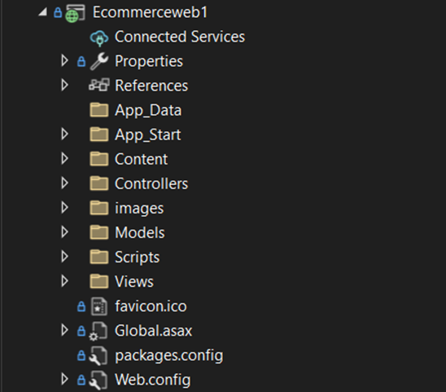
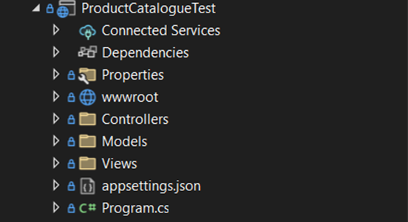
File Structure
.Net Framework: .Net Core:

Slide 5
Global Assembly Cache
.Net FrameWork: The GAC is used to store assemblies that are shared by multiple applications on the same machine. This allows for versioning and central management of assemblies, preventing issues like DLL Hell.
GAC was designed to solve issues of assembly versioning and sharing across applications in enterprise environments.
GAC is usually used for managing assemblies globally across applications on a system, which is particularly useful for traditional Windows-based applications.
.Net Core: .NET Core does not use the GAC. It adopts a different approach to assembly resolution.
Each application can have its own version of an assembly, and the application can specify which version of a library it requires. This eliminates the issue of version conflicts (such as DLL Hell) that existed in the .NET Framework's GAC.
.NET Core’s approach allows for easier distribution of applications with their dependencies, especially for containerized or cross-platform applications where using a central GAC would be problematic.

Slide 6
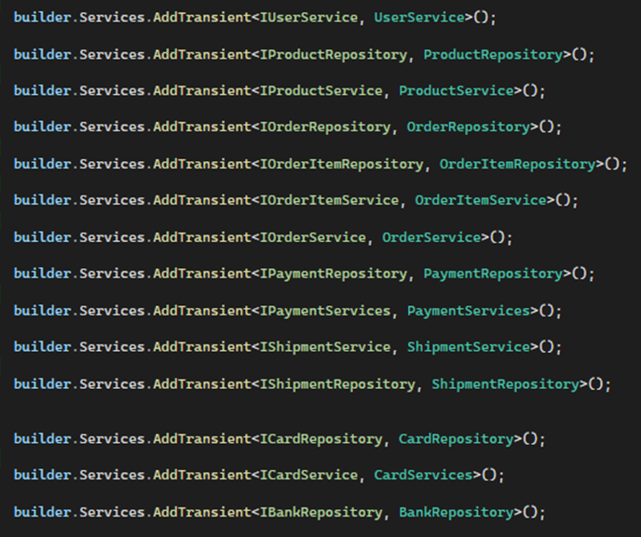
Dependency Injection
Dependency Injection (DI) is a design pattern that facilitates loose coupling and easier testing by injecting dependencies into classes instead of directly creating them.
Service Lifetime Management: .NET Core's DI container allows developers to easily control the lifetime of dependencies using built-in service lifetimes:
Transient: A new instance is created each time the service is requested.
Scoped: A new instance is created once per request (useful in web applications for per-request dependencies).
Singleton: A single instance is used throughout the application's lifetime.

Slide 7
DI in .Net Framework
In .NET Framework, Dependency Injection is not a built-in feature; instead, it is typically implemented through third-party libraries. Commonly used libraries include Unity, Autofac, Ninject, and Castle Windsor. These libraries allow for DI to be set up and configured manually.
Manual Setup: Developers need to explicitly configure and register services within a DI container provided by third-party libraries.
No Built-In DI Framework: .NET Framework does not include a built-in DI container, which means developers are responsible for setting up and managing the DI container, its configuration, and resolving dependencies.
Larger Overhead: As DI is not native, integrating third-party libraries often results in additional complexity and overhead in the configuration.

Slide 8




THANK YOU
(844) 720-6678
info@simplifyhealthcare.com
simplifyhealthcare.com
Simplify Healthcare
U.S.: 600 N Commons Drive, Suite 110, Aurora, IL 60504
India: 401/402, 4th Floor, Pentagon P-2, Magarpatta City, Pune 411013
CONNECT WITH US
LinkedIn
YouTube
X
Instagram

